Slide 1
Unit 10:
Sociotechnical System

Slide 2
Systems
Software engineering is not an isolated activity but is part of a broader systems engineering process.
Software systems are therefore not isolated systems but are essential components of broader systems that have a human, social or organizational purpose.
Example
  Wilderness weather system is part of broader weather recording and forecasting systems
  These include hardware and software, forecasting processes, system users, the organizations that depend on weather forecasts, etc.

Slide 3
Sociotechniocal Systems
For example
The wilderness weather system software controls the instruments in a weather station. It communicates with other software systems and is a part of wider national and international weather forecasting systems.
As well as hardware and software, these systems include processes for forecasting the weather, people who operate the system and analyze its outputs.
The system also includes the organizations that depend on the system to help them provide weather forecasts to individuals, government, industry, etc.
These broader systems are sometimes called sociotechnical systems. They include nontechnical elements such as people, processes, regulations, etc., as well as technical components such as computers, software, and other equipment.

Slide 4
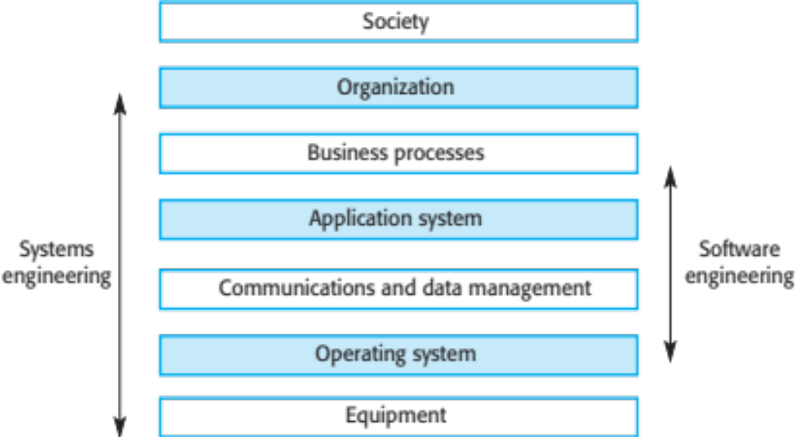
The sociotechnical systems stack

Slide 5
The layer of sociotechnical systems stack
Equipment
  Hardware devices, some of which may be computers. Most devices will include an embedded system of some kind.
Operating system
  Provides a set of common facilities for higher levels in the system.
Communications and data management
  Middleware that provides access to remote systems and databases.
Application systems
  Specific functionality to meet some organization requirements

Slide 6
The layer of sociotechnical systems stack
Business processes
  A set of processes involving people and computer systems that support the activities of the business.
Organizations
  Higher level strategic business activities that affect the operation of the system.
Society
  Laws, regulation and culture that affect the operation of the system.

Slide 7
Holistic System Design
There are interactions and dependencies between the layers in a system and changes at one level ripple through the other levels
  Example: Change in regulations (society) leads to changes in business processes and application software.
For dependability, a systems perspective is essential
  Contain software failures within the enclosing layers of the STS stack.
  Understand how faults and failures in adjacent layers may affect the software in a system.

Slide 8
What is a complex system?
A purposeful collection of inter-related components working together to achieve some common objective.
A system may include software, mechanical, electrical and electronic hardware and be operated by people.
System components are dependent on other system components
The properties and behavior of system components are inextricably inter-mingled. This leads to complexity.

Slide 9
System Categories
Technical computer-based systems
Systems that include hardware and software but where the operators and operational processes are not normally considered to be part of the system. The system is not self-aware.
Socio-technical systems
Systems that include technical systems but also operational processes and people who use and interact with the technical system. Socio-technical systems are governed by organizational policies and rules.

Slide 10
Organizational Affects
Process changes
  Systems may require changes to business processes so training may be required. Significant changes may be resisted by users.
Job changes
  Systems may de-skill users or cause changes to the way they work. The status of individuals in an organization may be affected by the introduction of a new system.
Organizational changes
  Systems may change the political power structure in an organization. If an organization depends on a system then those that control the system have more power.

Slide 11
Socio-technical System Characteristics
Emergent properties: Properties of the system of a whole that depend on the system components and their relationships.
Non-deterministic: They do not always produce the same output when presented with the same input because the systems' behavior is partially dependent on human operators.
Complex relationships with organizational objectives: The extent to which the system supports organizational objectives does not just depend on the system itself.

Slide 12
Emergent Properties
Properties of the system as a whole rather than properties that can be derived from the properties of components of a system
Emergent properties are a consequence of the relationships between system components
They can therefore only be assessed and measured once the components have been integrated into a system

Slide 13
Examples of Emergent Properties
Property | Description
Volume | The volume of a system (the total space occupied) varies depending on how the component assemblies are arranged and connected.
Reliability | System reliability depends on component reliability but unexpected interactions can cause new types of failures and therefore affect the reliability of the system.
Security | The security of the system (its ability to resist attack) is a complex property that cannot be easily measured. Attacks may be devised that were not anticipated by the system designers and so may defeat built-in safeguards.
Repairability | This property reflects how easy it is to fix a problem with the system once it has been discovered. It depends on being able to diagnose the problem, access the components that are faulty, and modify or replace these components.
Usability | This property reflects how easy it is to use the system. It depends on the technical system components, its operators, and its operating environment.

Slide 14
Types of Emergent Property
Functional properties
  These appear when all the parts of a system work together to achieve some objective. For example, a bicycle has the functional property of being a transportation device once it has been assembled from its components.
Non-functional emergent properties
  Examples are reliability, performance, safety, and security. These relate to the behaviour of the system in its operational environment. They are often critical for computer-based systems as failure to achieve some minimal defined level in these properties may make the system unusable.

Slide 15
Reliability as an Emergent Property
Because of component inter-dependencies, faults can be propagated through the system.
System failures often occur because of unforeseen inter relationships between components.
It is practically impossible to anticipate all possible component relationships.
Software reliability measures may give a false picture of the overall system reliability.

Slide 16
System Reliability Engineering
Because of component interdependencies, faults can be propagated through the system.
System failures often occur because of unforeseen interrelationships between relationships between components.
It is probably impossible to anticipate all possible component relationships.
Software reliability measures may give a false picture of the system give a false picture of the system reliability.

Slide 17
Influences on Reliability
Hardware reliability
  What is the probability of a hardware component failing and how long does it take to repair that component?
Software reliability
  How likely is it that a software component will produce an incorrect output. Software failure is usually distinct from hardware failure in that software does not wear out.
Operator reliability
  How likely is it that the operator of a system will make an error?
Failures are not independent and they propagate from one level to another.

Slide 18
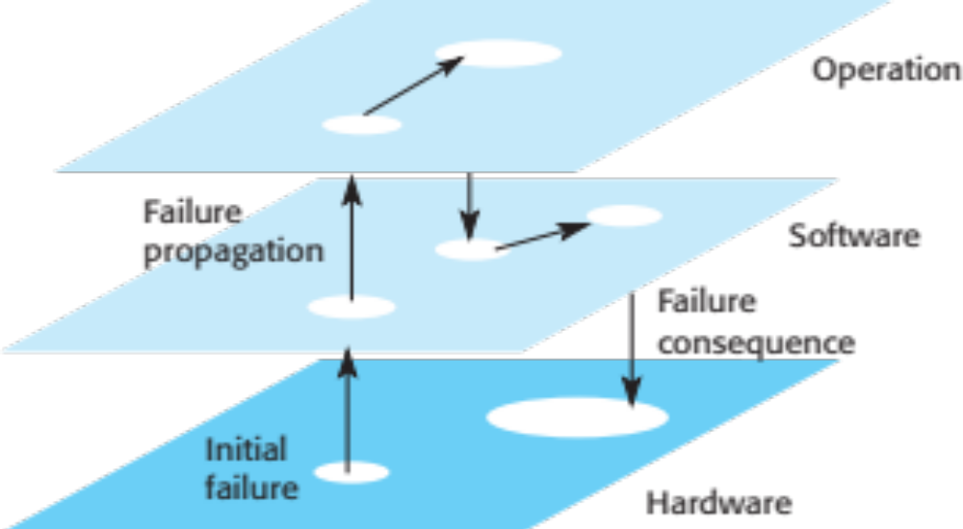
Failure Propagation

Slide 19
Non-determinism
A deterministic system is one where a given sequence of inputs will always produce the same sequence of outputs.
Software systems are deterministic; systems that include humans are non-deterministic
  A socio-technical system will not always produce the same sequence of outputs from the same input sequence
  Human elements
    People do not always behave in the same way
  System changes
    System behavior is unpredictable because of frequent changes to hardware, software and data.

Slide 20
Success Criteria
Complex systems are developed to address ‘wicked problems’ – problems where there cannot be a complete specification.
Different stakeholders see the problem in different ways and each has a partial understanding of the issues affecting the system.
Consequently, different stakeholders have their own views about whether or not a system is ‘successful’
  Success is a judgment and cannot be objectively measured.
  Success is judged using the effectiveness of the system when deployed rather than judged against the original reasons for procurement.

Slide 21
Systems Engineering
Procuring, specifying, designing, implementing, validating, deploying and maintaining socio-technical systems.
Concerned with the services provided by the system, constraints on its construction and operation and the ways in which it is used to fulfill its purpose or purposes.

Slide 22
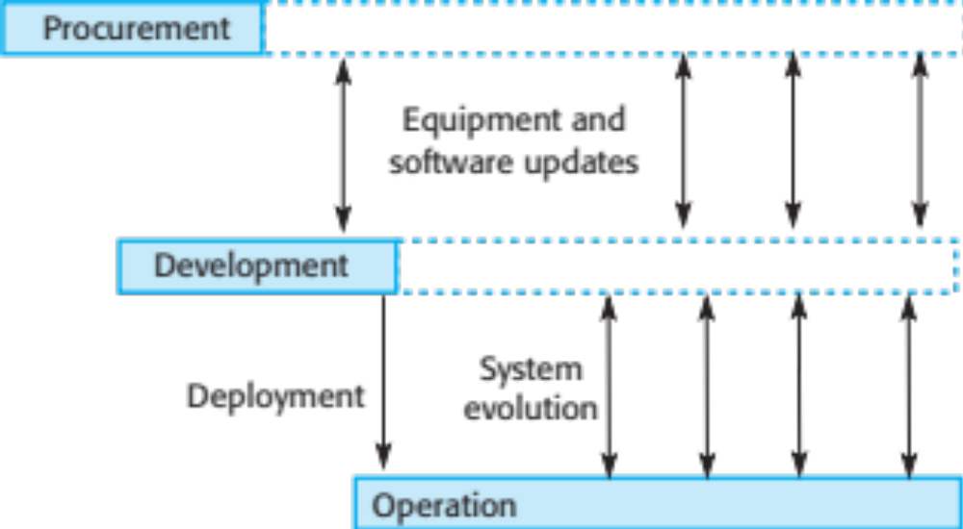
Stages of Systems Engineering

Slide 23
Systems engineering stages
Procurement (acquisition)
  The purpose of the system is established, high-level system requirements are defined, decisions are made on how functionality is distributed and the system components are purchased.
Development
  The system is developed – requirements are defined in detail, the system is implemented and tested and operational processes are defined.
Operation
  The system is deployed and put into use. Changes are made as new requirements emerge. Eventually, the system is decommissioned.

Slide 24
Security and Dependability Considerations
Design options limited by procurement decisions
  Purchased components may make some safeguards impossible to implement.
Human errors made during development may introduce faults into the system.
Inadequate testing may mean faults are not discovered before deployment.
Configuration errors during deployment may introduce vulnerabilities.
Assumptions made during procurement may be forgotten when system changes are made.

Slide 25
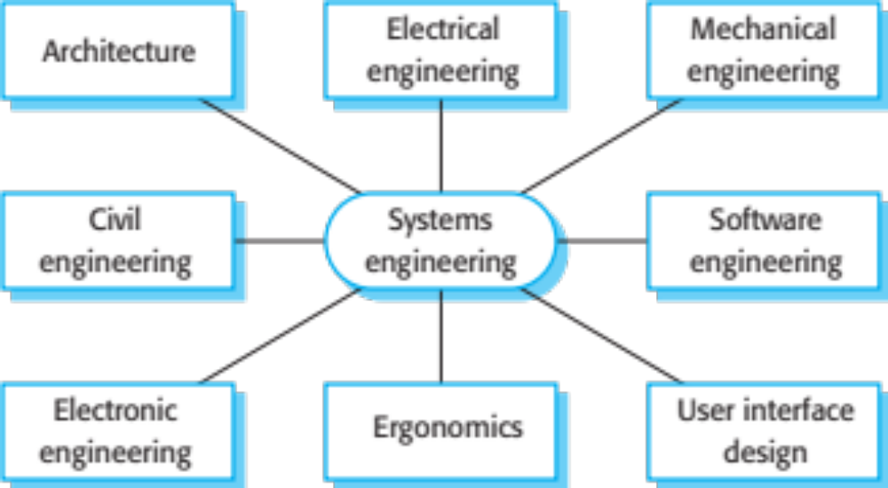
Professional Disciplines Involved in Systems Engineering

Slide 26
Inter-Disciplinary Working
Communication difficulties
  Different disciplines use the same terminology to mean different things. This can lead to misunderstandings about what will be implemented.
Differing assumptions
  Each discipline makes assumptions about what can and can’t be done by other disciplines.
Professional boundaries
  Each discipline tries to protect their professional boundaries and expertise and this affects their judgments on the system.

Slide 27
System Procurement
The initial phase of systems engineering is system procurement (sometimes called system acquisition).
At this stage, decisions are made on the scope of a system that is to be purchased, system budgets and timescales, and the high-level system requirements.
Using this information, further decisions are then made on whether to procure a system, the type of system required, and the supplier or suppliers of the system.

Slide 28
System Procurement
The drivers for these decisions are:
The state of other organizational systems: If the organization has a mixture of systems that cannot easily communicate or that are expensive to maintain, then procuring a replacement system may lead to significant business benefits.
The need to comply with external regulations: Increasingly, businesses are regulated and have to demonstrate compliance with externally defined regulations. This may require the replacement of noncompliant systems or the provision of new systems specifically to monitor compliance.

Slide 29
System Procurement
The drivers for these decisions are:
External competition: If a business needs to compete more effectively or maintain a competitive position, investment in new systems that improve the efficiency of business processes may be advisable. For military systems, the need to improve capability in the face of new threats is an important reason for procuring new systems.
Business reorganization: Businesses and other organizations frequently restructure with the intention of improving efficiency and/or customer service. Reorganizations lead to changes in business processes that require new systems support.
Available budget: The budget available is an obvious factor in determining the scope of new systems that can be procured.

Slide 30
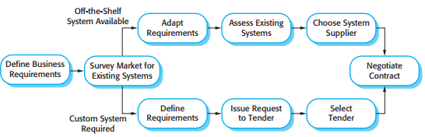
System Procurement Process
Large, complex systems usually consist of a mixture of off-the-shelf and specially built components.
The procurement processes for these different types of component are usually different.
System procurement processes

Slide 31
System Procurement Process
Off-the-shelf components do not usually match requirements exactly, unless the requirements have been written with these components in mind. Therefore, choosing a system means that you have to find the closest match between the system requirements and the facilities offered by off-the-shelf systems. You may then have to modify the requirements. This can have knock-on effects on other subsystems.

Slide 32
System Procurement Process
When a system is to be built specially, the specification of requirements is part of the contract for the system being acquired. It is therefore a legal as well as a technical document.
After a contractor has been selected, to build a system, there is a contract negotiation period where you may have to negotiate further changes to the requirements and discuss issues such as the cost of changes to the system. Similarly, once a COTS system has been selected, you may negotiate with the supplier on costs, license conditions, possible changes to the system, etc.

Slide 33
System Development
Usually follows a plan-driven approach because of the need for parallel development of different parts of the system
  Little scope for iteration between phases because hardware changes are very expensive. Software may have to compensate for hardware problems.
Inevitably involves engineers from different disciplines who must work together
  Much scope for misunderstanding here.
  As explained, different disciplines use a different vocabulary and much negotiation is required. Engineers may have personal agendas to fulfill.

Slide 34
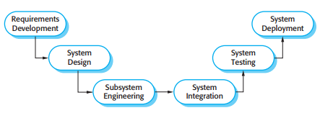
System Development
The goals of the system development process are to develop or acquire all of the components of a system and then to integrate these components to create the final system

Slide 35
System Development
Three types of requirement defined at this stage
Abstract functional requirements: System functions are defined in an abstract way
System properties: Non-functional requirements for the system in general are defined
Undesirable characteristics: Unacceptable system behavior is specified.
System Development should also define overall organizational objectives for the system.

Slide 36
Requirement & Design
Requirements engineering and system design are inextricably linked.
Constraints posed by the system’s environment and other systems limit design choices so the actual design to be used may be a requirement.
Initial design may be necessary to structure the requirements.
As you do design, you learn more about the requirements.

Slide 37
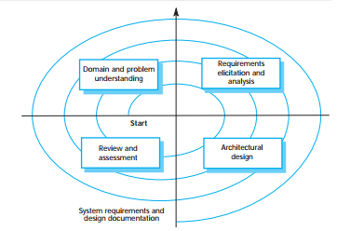
Requirement & Design Spiral

Slide 38
Sub System Development
Typically parallel projects developing the hardware, software and communications.
May involve some COTS (Commercial Off-the-Shelf) systems procurement.
Lack of communication across implementation teams can cause problems.
There may be a bureaucratic and slow mechanism for proposing system changes, which means that the development schedule may be extended because of the need for rework.

Slide 39
System Integration
The process of putting hardware, software and people together to make a system.
Should ideally be tackled incrementally so that subsystems are integrated one at a time.
The system is tested as it is integrated.
Interface problems between sub-systems are usually found at this stage.
May be problems with uncoordinated deliveries of system components.

Slide 40
System Delivery and Deployment
After completion, the system has to be installed in the customer’s environment
  Environmental assumptions may be incorrect
  May be human resistance to the introduction of a new system
  System may have to coexist with alternative systems for some time
  May be physical installation problems (e.g. cabling problems)
  Data cleanup may be required
  Operator training has to be identified.

Slide 41
Development and Dependability
Decisions are made on dependability and security requirements and trade-offs made between costs, schedule, performance and dependability.
Human errors may lead to the introduction of faults into the system.
Testing and validation processes may be limited because of limited budgets.
Problems in deployment mean there may be a mismatch between the system and its operational environment.

Slide 42
System Operation
Operational processes are the processes involved in using the system for its defined purpose.
For new systems, these processes may have to be designed and tested and operators trained in the use of the system.
Operational processes should be flexible to allow operators to cope with problems and periods of fluctuating workload.

Slide 43
Human Error
Human errors occur in operational processes that influence the overall dependability of the system.
Viewing human errors:
  The person approach makes errors the responsibility of the individual and places the blame for error on the operator concerned. Actions to reduce error include threats of punishment, better training, more stringent procedures, etc.
  The systems approach assumes that people are fallible and will make mistakes. The system is designed to detect these mistakes before they lead to system failure. When a failure occurs, the aim is not to blame an individual but to understand why the system defenses did not trap the error.

Slide 44
System Defense
To improve security and dependability, designers should think about the checks for human error that should be included in a system.
There should be multiple (redundant) barriers which should be different (diverse)
No single barrier can be perfect: There will be latent conditions in the system that may lead to failure.
However, with multiple barriers, all have to fail for a system failure to occur.

Slide 45
System Evolution
Large systems have a long lifetime. They must evolve to meet changing requirements.
Evolution is inherently costly
  Changes must be analyzed from a technical and business perspective
  Sub-systems interact so unanticipated problems can arise
  There is rarely a rationale for original design decisions
  System structure is corrupted as changes are made to it.
Existing systems which must be maintained are sometimes called legacy systems.

Slide 46
System Evolution and Dependability
Changes to a system are often a source of problems and vulnerabilities.
Changes may be made without knowledge of previous design decisions made for security and dependability reasons.
  Built-in safeguards may stop working.
New faults may be introduced or latent faults exposed by changes.
  These may not be discovered because complete system retesting is too expensive.

Slide 47
Key points
Socio-technical systems include computer hardware, software and people and are designed to meet some business goal.
Human and organizational factors, such as the organizational structure, have a significant effect on the operation of socio-technical systems.
Emergent properties are properties that are characteristic of the system as a whole and not its component parts.
The fundamental stages of systems engineering are procurement, development and operation.

